Slide 1
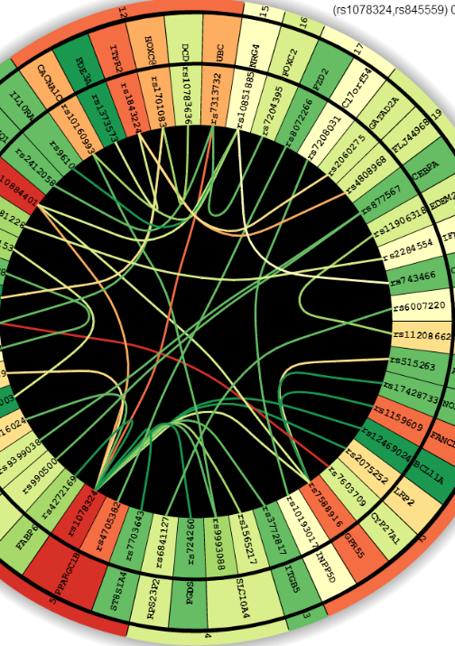

EINVis:
A visualization tool for analyzing and exploring genetic interactions in large-scale association studies
Yubao Wu
Xiaofeng Zhu
Jian Chen
Xiang Zhang
EECS, CWRU
EPBI, CWRU
CSEE, UMBC
EECS, CWRU
EINVis : http://filer.case.edu/yxw407/einvis/
Notes:
Hi, everyone. I am gonna talk about EINVis: a visualization tool for analyzing and exploring genetic interactions in large-scale association studies.

Slide 2
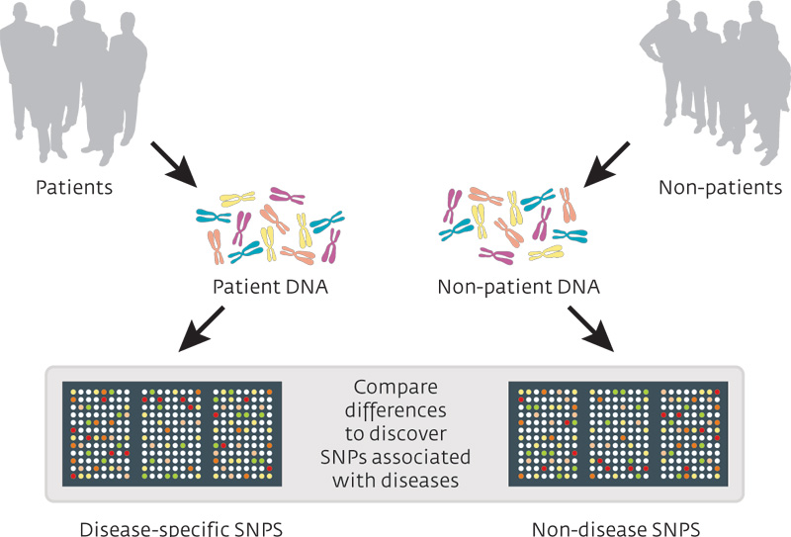
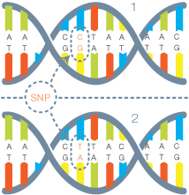
Motivation : Genome-Wide Association Study
Genetic Marker
(single-nucleotide)
Notes:
This work is motivated from the genome wide association study. In genome wide association study, the scientists collect the genetic data from the healthy people and patients. Then they compare the genetic differences, and try to discover the genetic markers, which are associated with the disease.

Slide 3
Motivation : Data
Individuals | Traits | Genetic Markers
 |  | Maker 1 | Maker 2 | Maker 3 | Maker 4
Patient 1 | Hypertension | A, G | G, G | G, G | G, G
Patient 2 | Hypertension | A, G | A, G | A, G | G, G
Patient 3 | Hypertension | A, G | A, A | A, G | A, G
Non-Patient 1 | Healthy | A, A | A, A | A, A | A, G
Non-Patient 2 | Healthy | A, A | A, A | A, G | A, G
Non-Patient 3 | Healthy | A, A | A, G | A, A | G, G
Notes:
This table shows the collected data. Some patients have hypertension disease; the other individuals are healthy. Millions of genetic markers are measured. We want to find which genetic markers are associated with the disease. Then, we calculate the correlation between the genetic markers and the disease trait.

Slide 4
Motivation : Single-Locus Test
Genetic Markers |  |  | Chi-square test score
Chr. | Gene | Maker ID
6 | ESR1 | rs11155820 | 1.18
16 | SLC12A3 | rs11076172 | 1.01
2 | ABCG5 | rs10495909 | 0.96
12 | MYO1H | rs7308864 | 0.92
17 | PEMT | rs4646405 | 0.83
11 | CTSF | rs560556 | 0.74
Notes:
We can calculate the correlation between one genetic maker and the disease trait, and get the single-locus test score.

Slide 5
Motivation : Two-Locus Test
Genetic Marker 1 |  |  | Genetic Marker 2 |  |  | Chi-square test score
Chr. | Gene | Maker ID | Chr. | Gene | Marker ID
16 | SLC12A3 | rs11076172 | 2 | ABCG5 | rs10495909 | 3.29
16 | SLC12A3 | rs11076172 | 6 | THBS2 | rs9294977 | 2.89
16 | SLC12A3 | rs11076172 | 6 | HDAC2 | rs13194921 | 2.43
12 | MYO1H | rs7308864 | 6 | ESR1 | rs11155820 | 2.10
17 | PEMT | rs4646405 | 6 | ESR1 | rs11155820 | 1.46
11 | CTSF | rs560556 | 2 | ABCG5 | rs10495909 | 1.12
Notes:
We can calculate the correlation between two genetic makers and the disease trait, and get the two-locus test score.

Slide 6
How to interpret the results more efficiently?
Examine the top ranking result one by one
Boring
Hard to find patterns
Visualization tool
Visualize the data
Friendly user interface to explore the data
Notes:
After we calculate the statistical tests, people usually examine the top ranking result one by one. But this is boring, and hard to find interesting patterns. How to explore the results more efficiently?
We need to a visualization tool. The tool should not only visualize the results, but also provide friendly user interface. So users can explore the data, and discover interesting patterns.

Slide 7
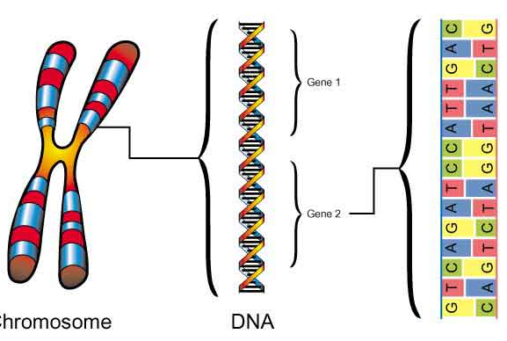
Hierarchical Structure and Compound Graph
Compound Graph
Virtual Root
Gene 1
Chromosomes
Gene 2
Genes
Genetic
Markers
Chromosome
DNA
Notes:
Each chromosome contains some genes. Each gene contains some genetic markers. Thus there is a hierarchical structure. This can help us better organize the data. We have this hierarchical tree structure and the network among the leaf nodes. We call this compound graph.
Previously, we calculate the statistical correlations. We treat the single-locus test as the node weight, and the two-locus test score as the edge weight.

Slide 8
Hierarchical Structure and Compound Graph
Compound Graph
Virtual Root
Gene 1
Chromosomes
Gene 2
Genes
Genetic
Markers
Chromosome
DNA
Single-Locus Test Score
Two-Locus Test Score
Notes:
Each chromosome contains some genes. Each gene contains some genetic markers. Thus there is a hierarchical structure. This can help us better organize the data. We have this hierarchical tree structure and the network among the leaf nodes. We call this compound graph.
Previously, we calculate the statistical correlations. We treat the single-locus test as the node weight, and the two-locus test score as the edge weight.

Slide 9
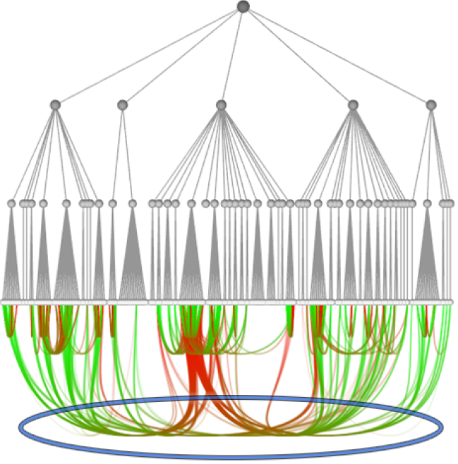
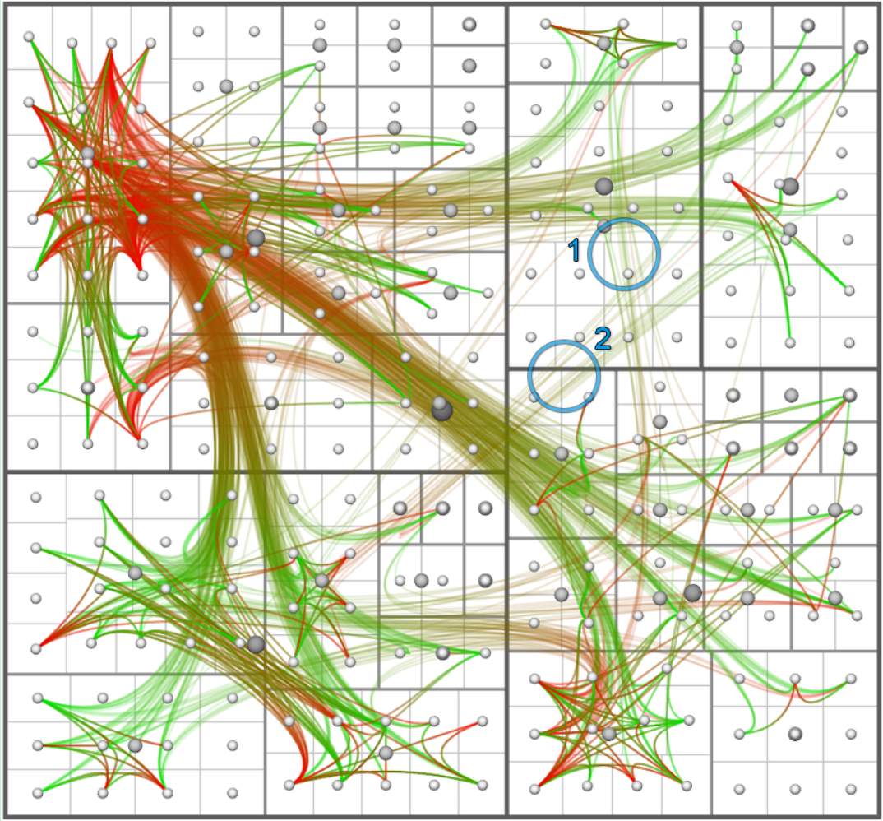
Visualization of Compound Graph
Tree Ring
Balloon Tree
Rooted Tree
Tree Map
Danny Holten. Hierarchical Edge Bundles: Visualization of Adjacency Relations in Hierarchical Data. TVCG, 2006.
Notes:
Some layouts are specially designed for the compound graph, such as tree ring view, rooted tree view, balloon tree view, and tree map view. The rooted tree view has large edge density in the bottom region, thus it is inferior. The balloon tree view and tree map view have overlaps between nodes and edges, thus it causes confusion. So we choose the tree ring view.

Slide 10
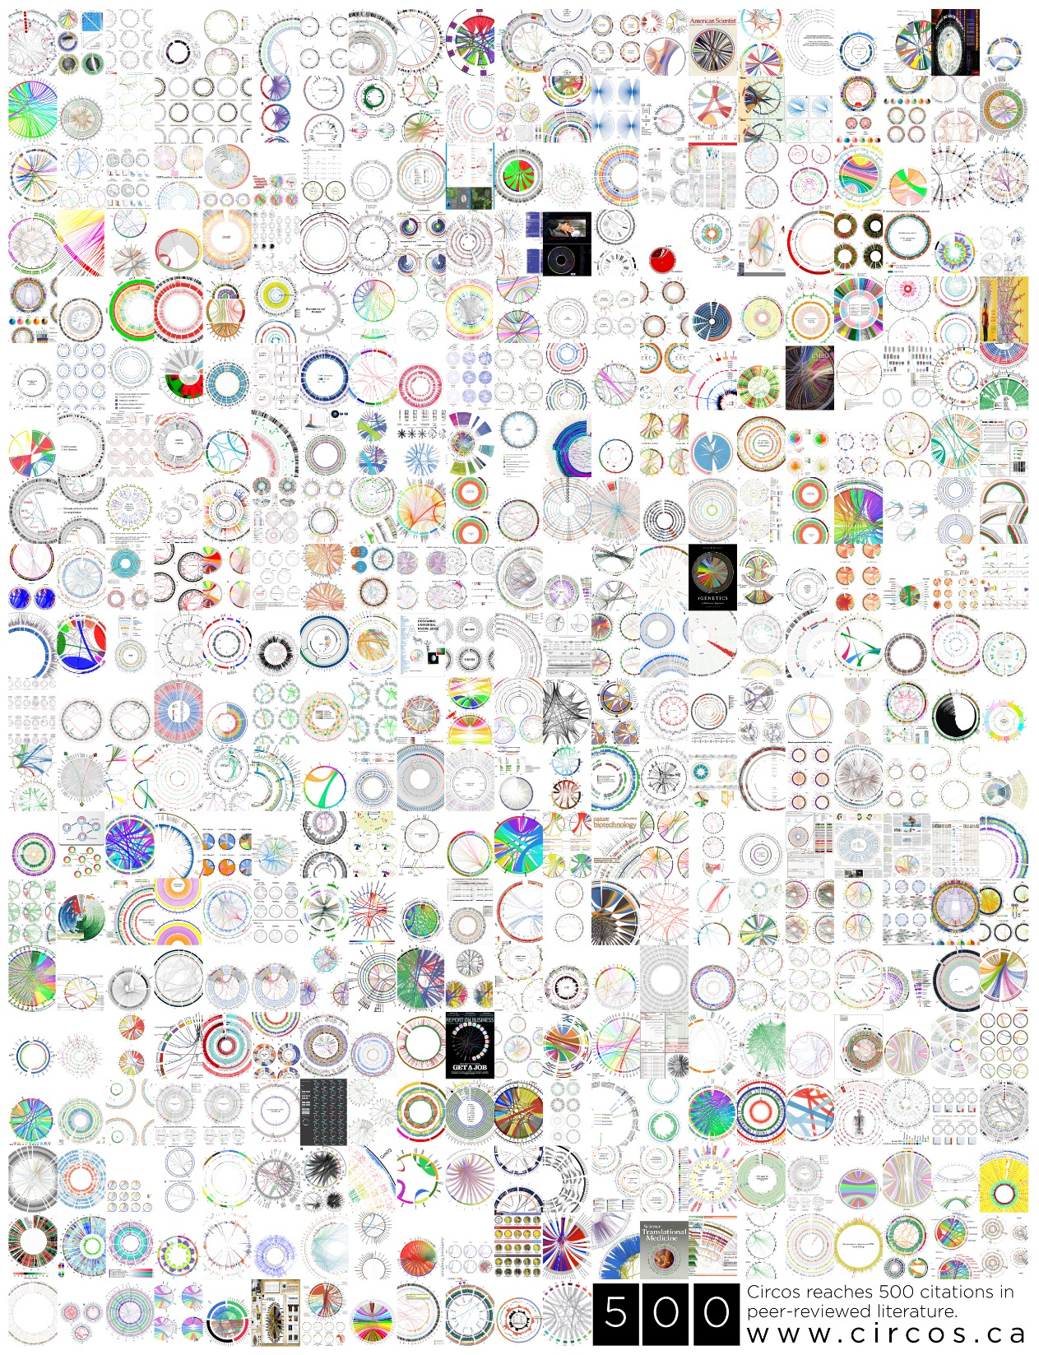
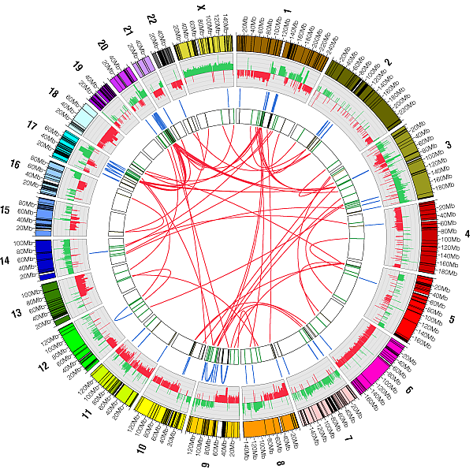
CIRCOS
Circos: http://www.circos.ca/
Notes:
The tree ring view has been used to visualize the data in hundreds of papers. The CIRCOS is specially designed for the tree ring view. Why not use this existing tool?
Because we need more flexibility when developing the software. So that we can provide more friendly user interface. There are many restriction when using the existing tool.

Slide 11
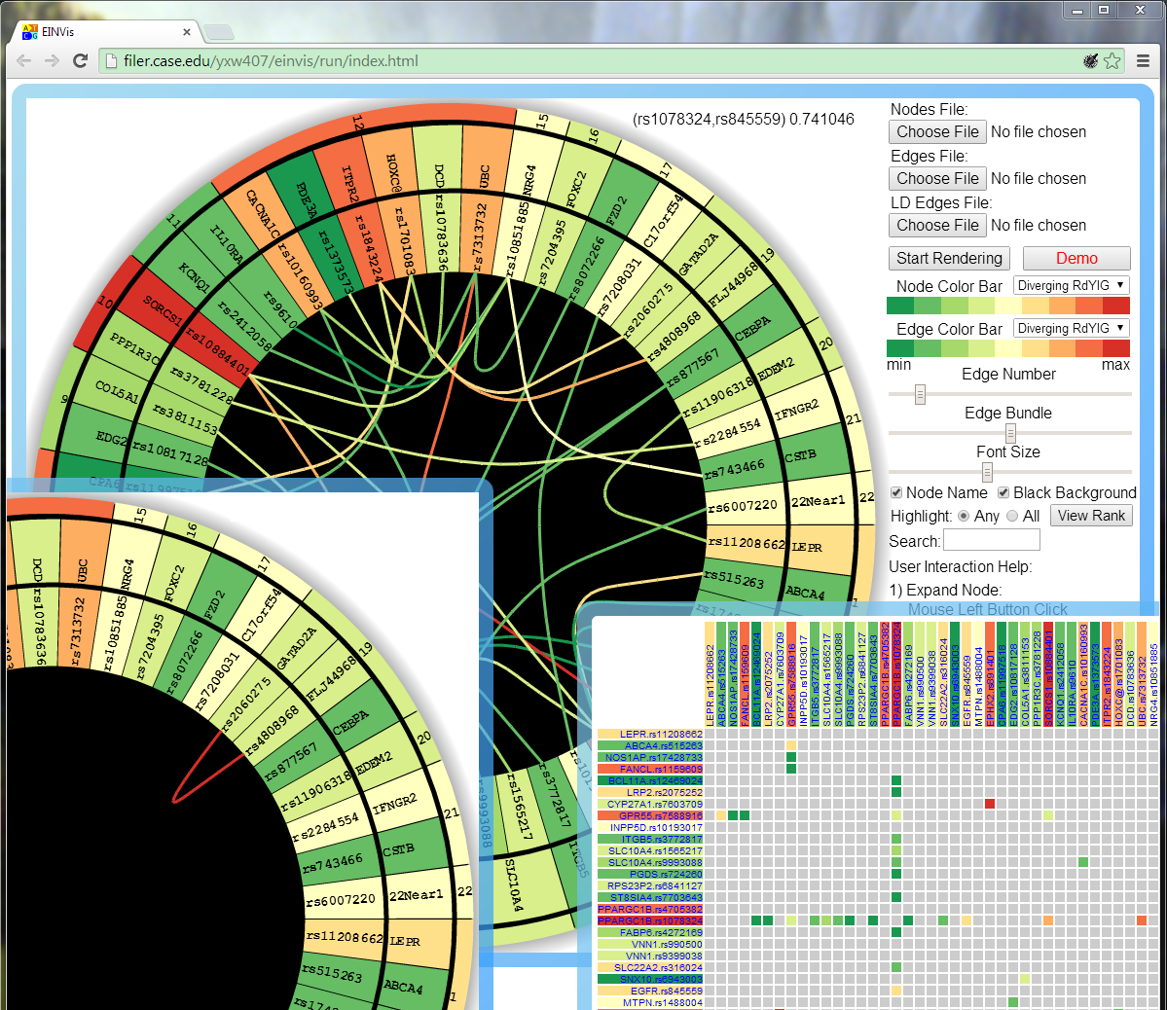
Tree Ring View 1
Tree Ring View 2
Matrix View
Linkage Disequilibrium
Genetic Association
Notes:
This is the EINVis software. You can run it within a web browser. There are three views. The first tree ring view and the matrix view visualize the genetic association data, and the second tree ring view visualizes another set of relationships.

Slide 12
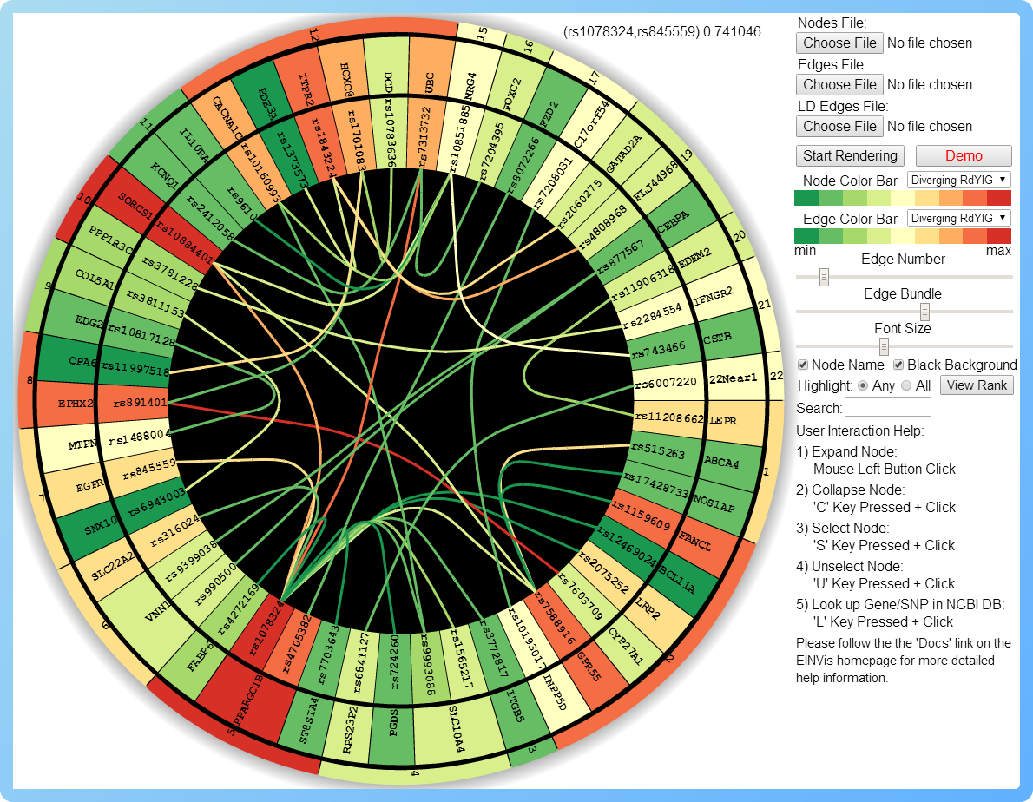
Node Color: Single-locus test score
Chromosome
Gene
Marker
Edge Color: Two-locus test score
Notes:
In the first tree ring view, each node is rendered as a ring sector. The nodes in the inner ring represent the genetic markers. The nodes in the middle ring represent the genes. The nodes in the outer ring represents the chromosomes. So, this tree ring view naturally represents the three-level hierarchical structure.
The node color represents the single-locus test score. The edge color represents the two-locus test score.

Slide 13
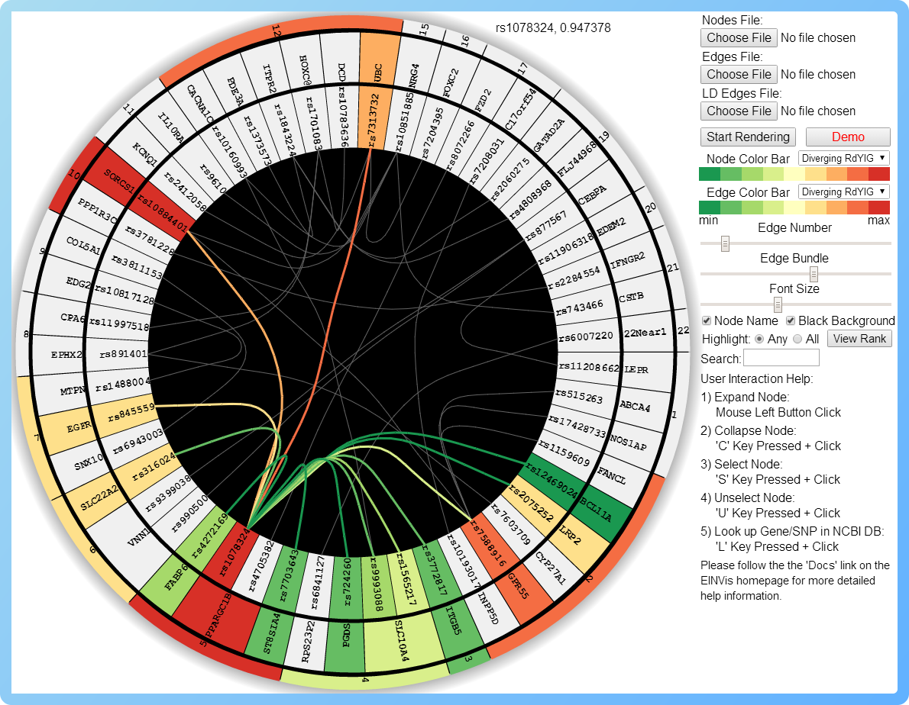
Highlighting One Node
Notes:
We can highlight interested node. For example, we find that this maker is connected to many other markers. Then, we can highlight this node and its related edges. So, we can see the interactions more clearly.

Slide 14
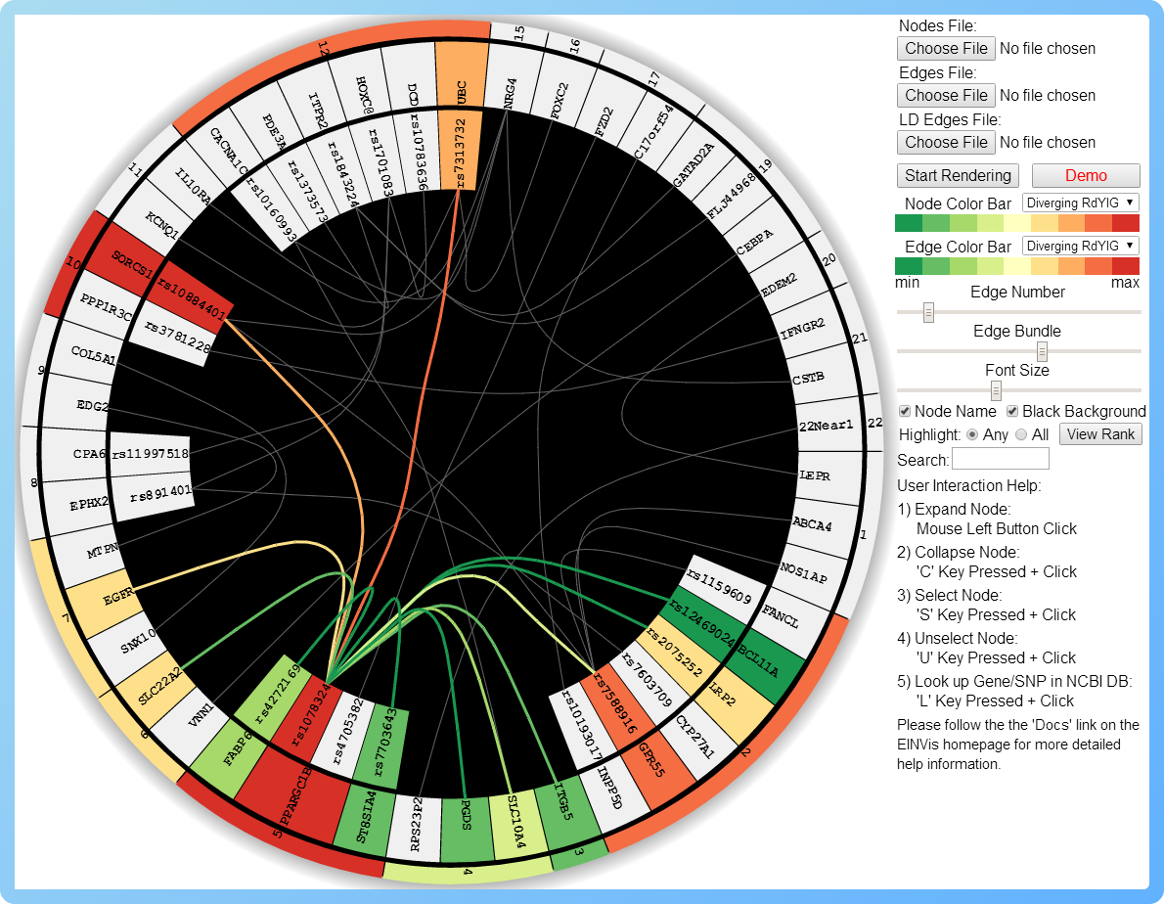
Collapsing Nodes
Notes:
We can also collapse and expand the nodes. This allows us not only focus on the interested nodes, but also observe the interactions at different levels.

Slide 15
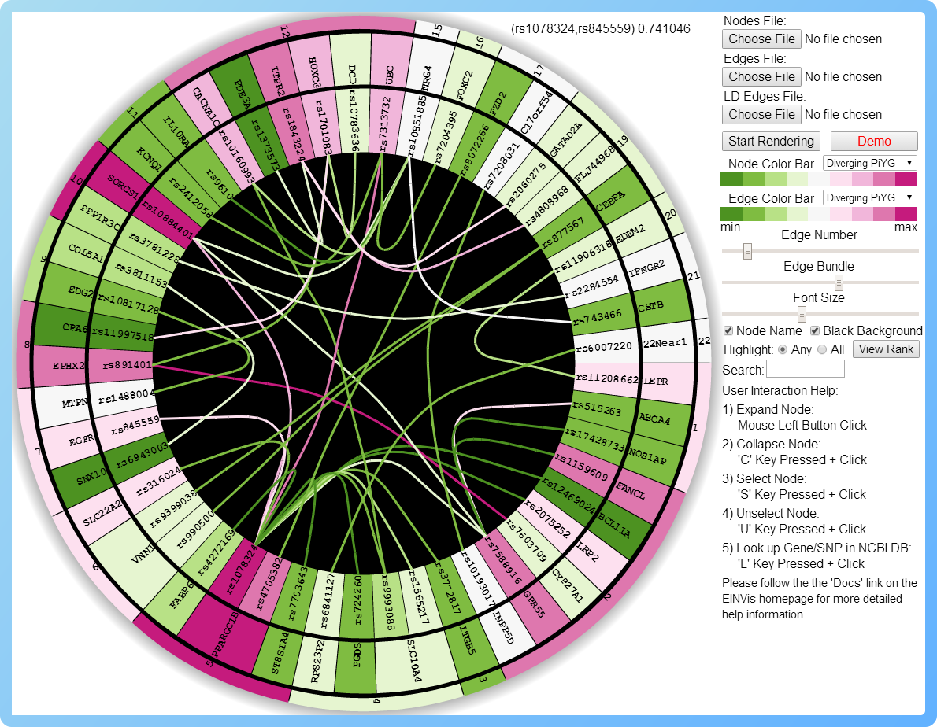
Changing Color Bar ColorBrewer: http://colorbrewer2.org/
Notes:
User can also change the color bar. They can select the preferred colors.

Slide 16
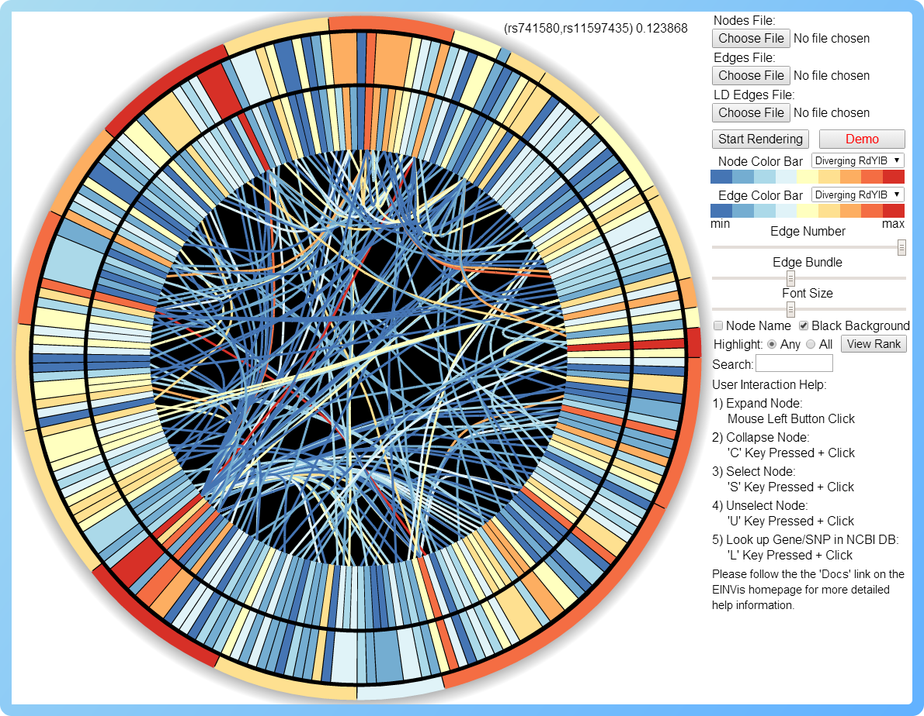
Visualizing More Nodes and Edges
Notes:
User can also increase the number of nodes and edges as well as hide the names of the nodes.

Slide 17
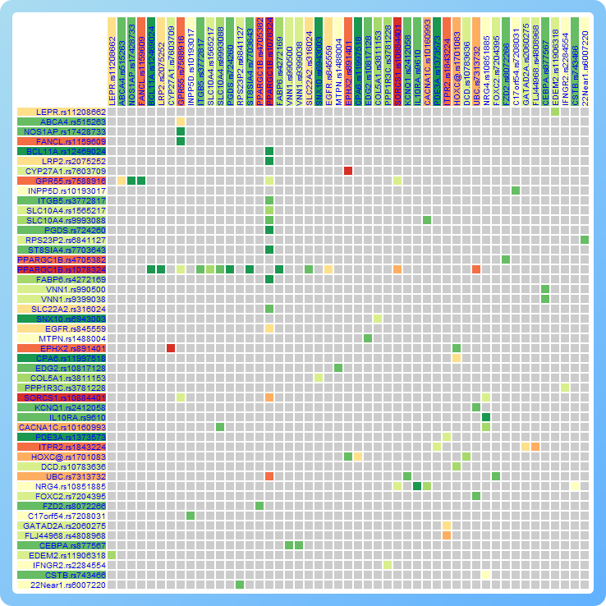
Matrix View: Genetic Associations
Gene.Marker
Node Color: Single-locus test score
Edge Color: Two-locus test score
Notes:
This is the matrix view. It visualizes the single and two-locus test scores in the form of a matrix.

Slide 18
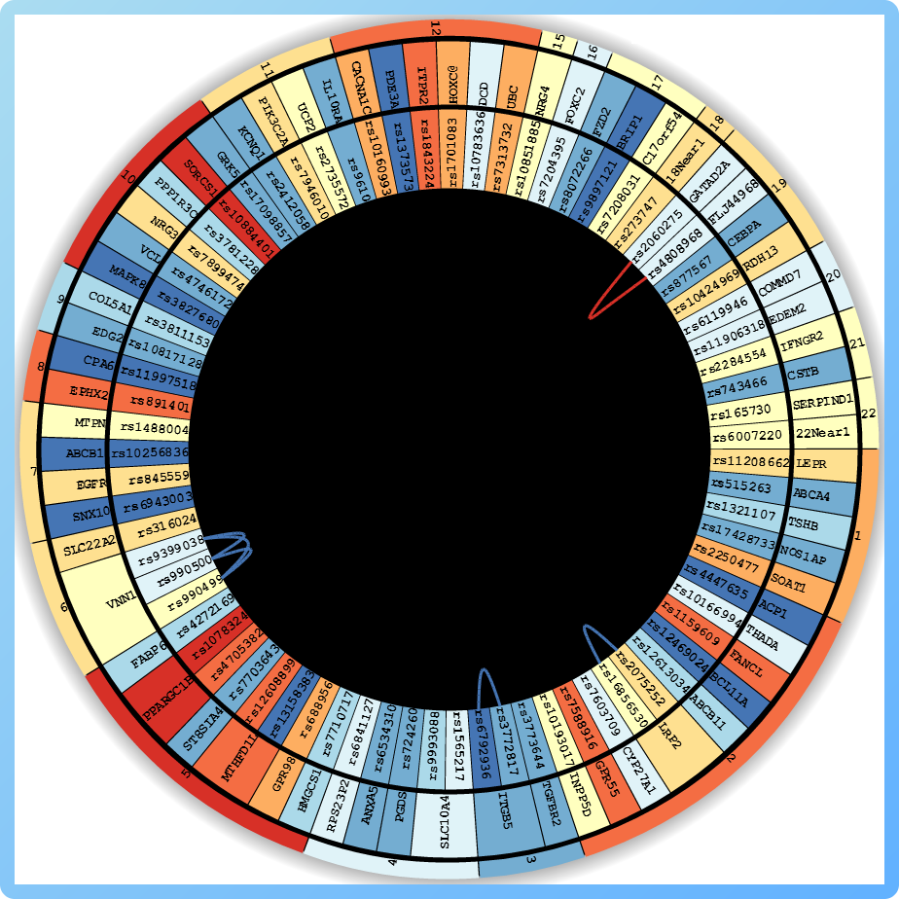
Another Tree Ring View: Linkage Disequilibrium
Notes:
This tree ring view visualizes another set of relationships among the genetic markers. Similarly, we can add multiple views, and visualize multiple types of relationships among the same set of nodes.

Slide 19



What resources are required to build tools?
HTML 5
HTML 5 Canvas
Notes:
What resources are required to build the tools? We use JavaScript programming language. We also use many elements in HTML 5. Specially, we use the Canvas element to draw the graphics on a webpage.

Slide 20
Conclusion
EINVis : visualize and explore the data
Hierarchical structure + Genetic associations
Friendly user interface
Future work
More views for different types of data
Towards large scale networks
EINVis : http://filer.case.edu/yxw407/einvis/
Notes:
In conclusion, EINVis is designed to visualize and explore the genetic data. It visualizes the hierarchical structure and the genetic association in a tree ring view. And it provides friendly user interface.
In the future, we want to add more views for different type of data. We also plan to improve it to visualize large scale networks.
Thanks.

